Slide 1


CSA0622 - DESIGN AND ANALYSIS OF ALGORITHMS
SMART ROUTE OPTIMIZATION USING DIJKSTRA’S ALGORITHM FOR INTELLIGENT NAVIGATION SYSTEMS
Under The Supervision :
D Manikavelan
Presented By:
P. Muni Karthik (192425061)
Chamakuri Sriram (192372279)
P. Kesava Reddy (192525088)

Slide 2
ABSTRACT
Navigation systems need efficient methods to identify the best route between two locations.
This project models a road network as a weighted graph, where locations represent vertices and roads represent weighted edges.
Dijkstra’s Algorithm is used to determine the shortest path between a given source and destination.
The algorithm uses a greedy approach to repeatedly select the location with the smallest known distance.
A priority queue is used to improve the efficiency of selecting the next location for processing.

Slide 3
INTRODUCTION
Navigation systems help users travel efficiently between different locations.
A road network can be represented mathematically using a graph.
Locations are represented as vertices or nodes in the graph.
Roads connecting locations are represented as edges.
Distance or travel cost is assigned as a weight to each edge.
The system needs to determine the route having the minimum total cost.
Dijkstra’s Algorithm provides an efficient solution for this shortest-path problem.

Slide 4
PROBLEM STATEMENT
A navigation network contains multiple locations connected by different roads.
Each road has an associated distance, travel time, or cost.
There may be multiple possible routes between the source and destination.
Manually comparing every possible route becomes inefficient as the network grows.
The system must identify the route with the minimum total weight.
The source location and destination location are provided as inputs.
Dijkstra’s Algorithm processes the network to determine the shortest path.

Slide 5
OBJECTIVES
To understand the shortest-path problem in graph theory.
To represent a real-world road network using a weighted graph.
To implement Dijkstra’s Algorithm for route optimization.
To determine the shortest route between a given source and destination.
To calculate the minimum total distance or travel cost.
To use appropriate data structures such as adjacency lists and priority queues.
To analyze the time and space complexity of the algorithm.

Slide 6
WHY DIJKSTRA’S ALGORITHM?
Our project is fundamentally a shortest-path problem.
Navigation networks naturally form weighted graphs.
Road distances and travel costs are normally non-negative.
Dijkstra’s Algorithm is specifically designed for this type of problem.
It uses a greedy approach to select the closest unvisited vertex.
It efficiently calculates minimum distances from a source vertex.
A priority queue can improve its efficiency for large graphs.

Slide 7
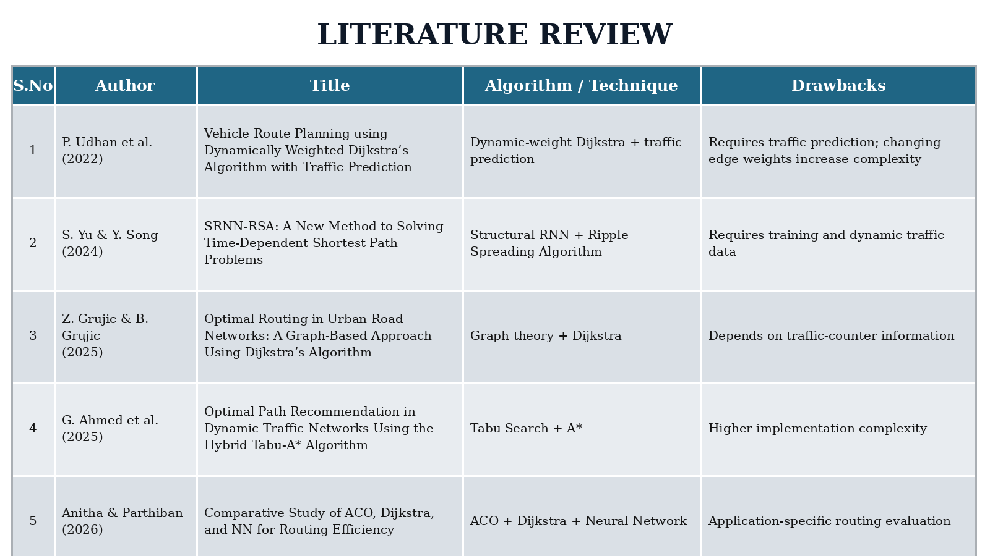

Slide 8
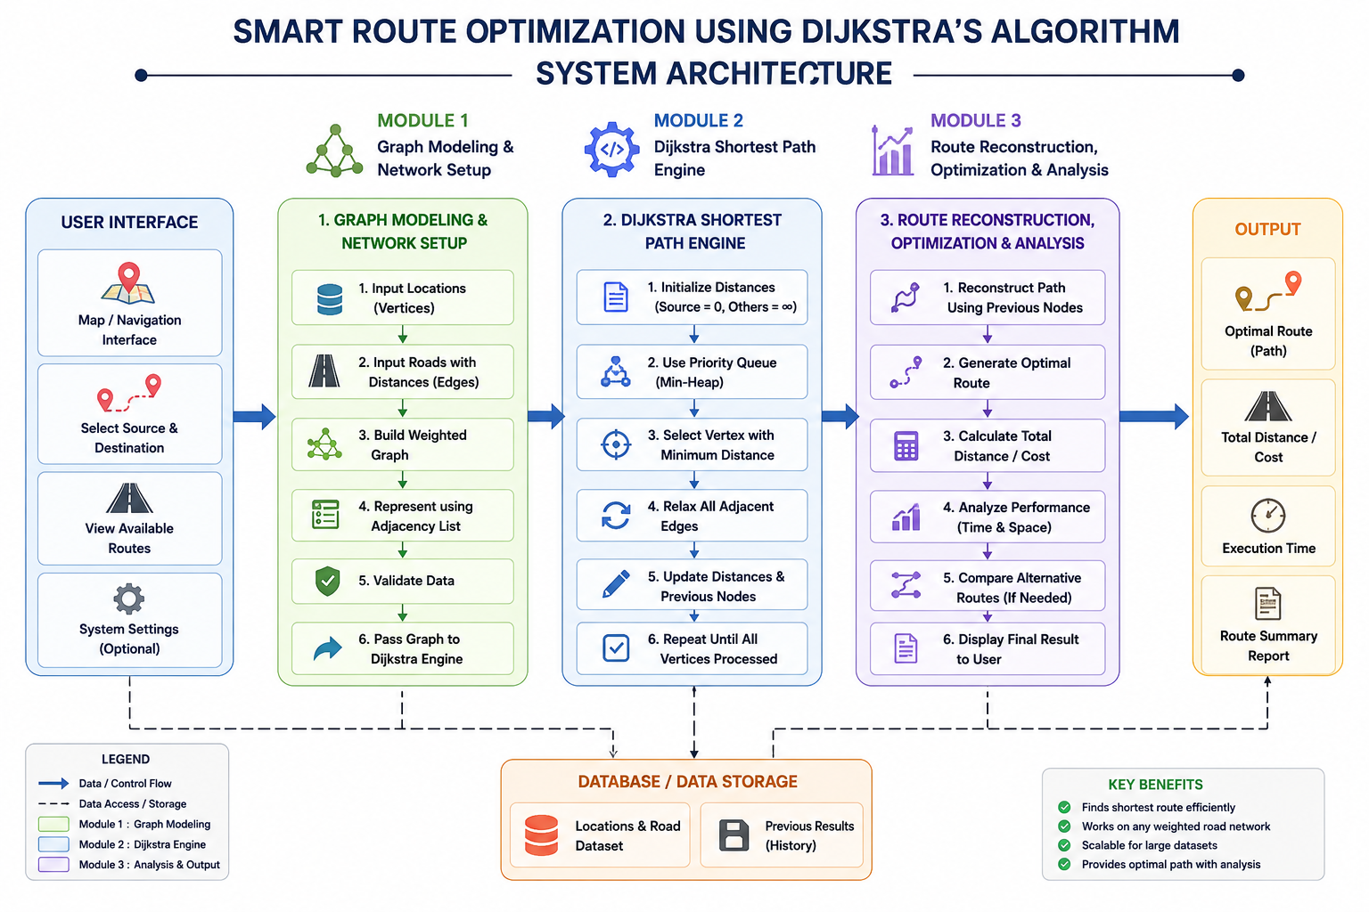
ARCHITECTURE DIAGRAM

Slide 9
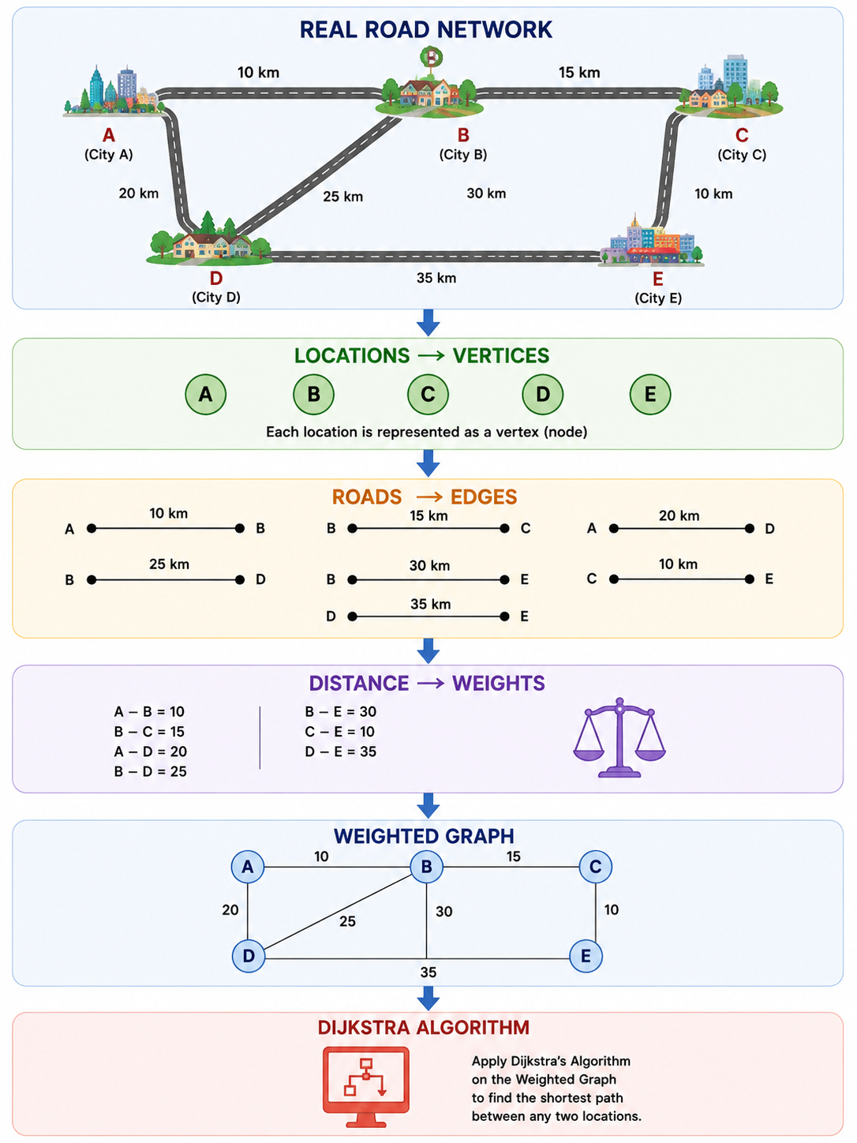
MODULE 1 — NAVIGATION NETWORK & GRAPH MODELING
What this module does
Collects the list of locations.
Creates vertices for each location.
Creates edges representing roads.
Assigns distance/cost to each road.
Represents the graph using an adjacency list.
Accepts source and destination locations.
Validates whether the requested locations and roads exist.
Provides the graph to the Dijkstra module.

Slide 10
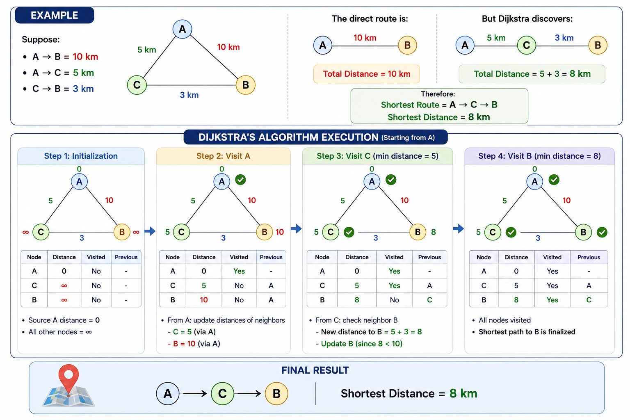
MODULE 2 — DIJKSTRA SHORTEST PATH ENGINE
What this module does
Receives the weighted graph from Module 1.
Initializes the distance of every vertex.
Sets source distance to 0.
Uses a priority queue/min-heap.
Selects the vertex with minimum tentative distance.
Performs edge relaxation.
Updates shorter distances.
Stores the previous vertex for path reconstruction.

Slide 11
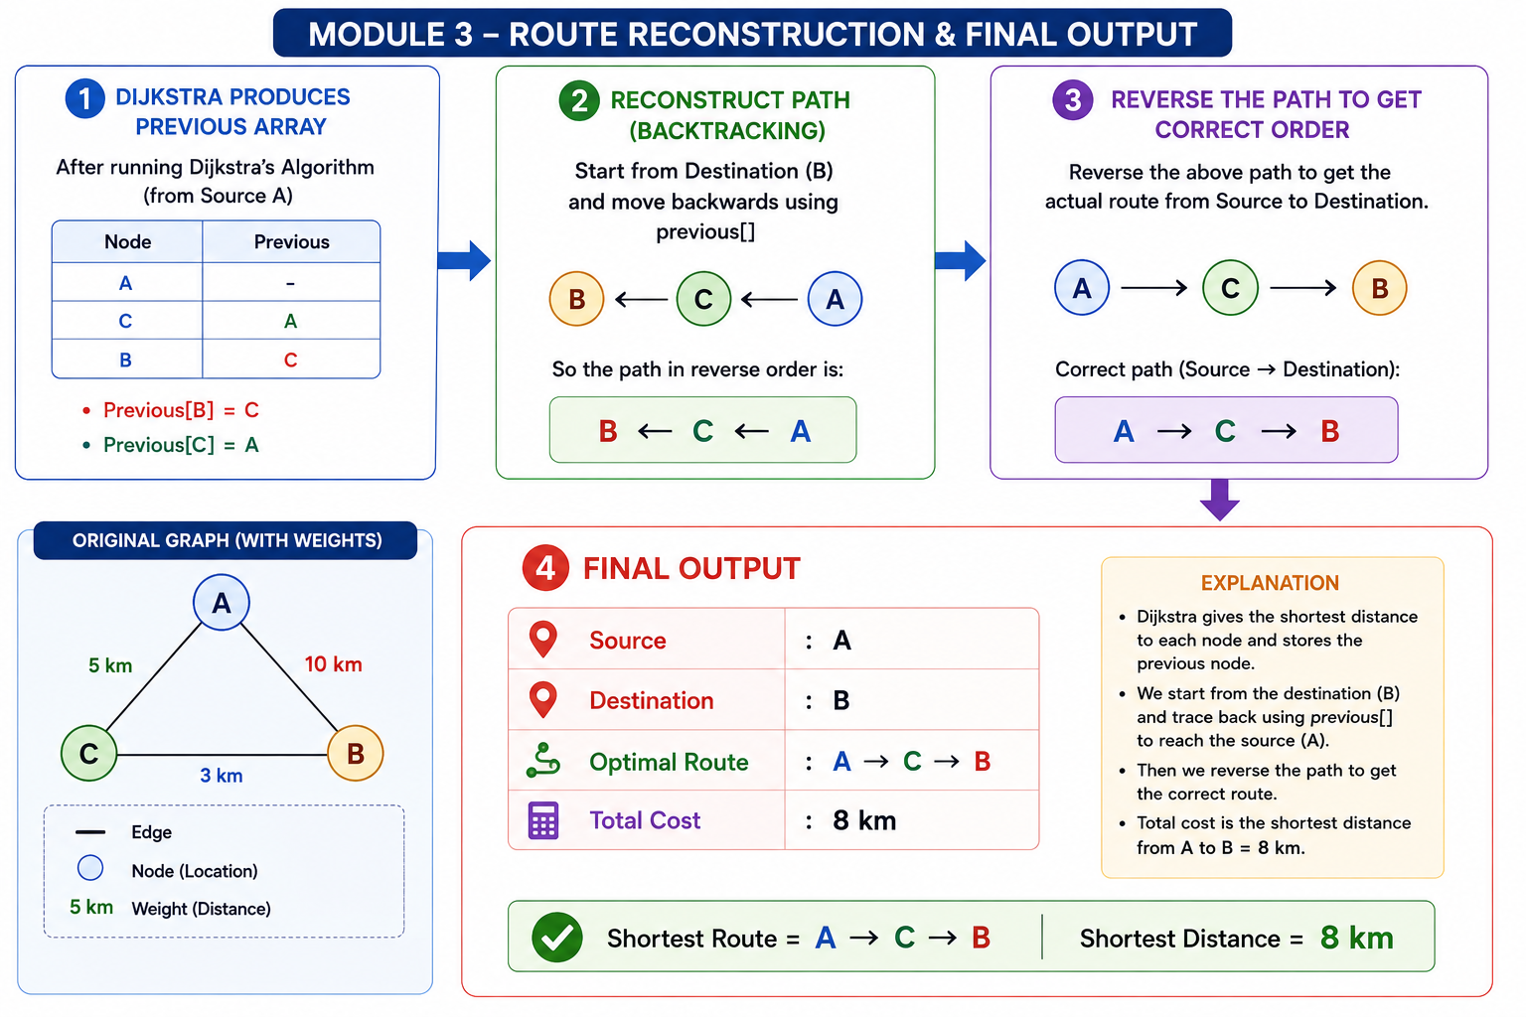
MODULE 3 — ROUTE RECONSTRUCTION, OPTIMIZATION & PERFORMANCE ANALYSIS
What this module does
Reconstructs the actual route using the previous array/dictionary.
Displays the source and destination.
Displays the selected route.
Displays the total distance/cost.
Compares possible routes where appropriate.
Measures execution time for different graph sizes.
Analyzes time and space complexity.

Slide 12
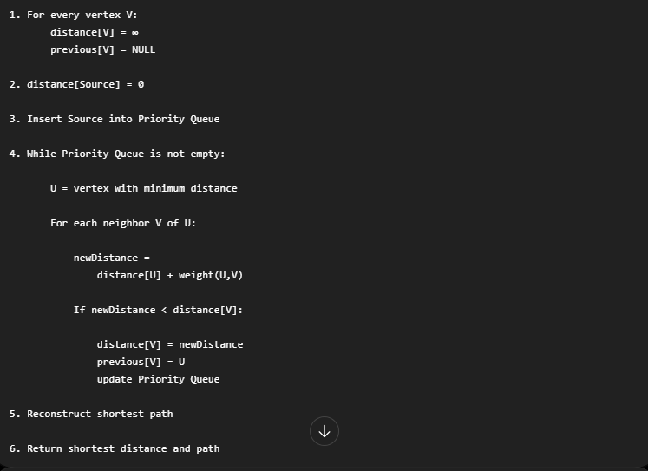
DIJKSTRA ALGORITHM / PSEUDOCODE

Slide 13
APPLICATIONS
Real-World Applications
GPS navigation systems
Google Maps-like route planning
Computer network routing
Delivery and logistics optimization
Robot path planning
Emergency vehicle routing
Public transportation route planning

Slide 14
CONCLUSION
The project applies Dijkstra's Algorithm to a navigation problem.
The road network is modeled as a weighted graph.
Dijkstra determines the shortest path between locations.
Edge relaxation helps update better routes.
Path reconstruction generates the actual navigation route.
Complexity analysis demonstrates the efficiency of the solution.
The project demonstrates a practical application of a fundamental DAA algorithm.

Slide 15


